Slide 1
CEIS310 Module 2
Planning Your Project and Data Cleansing
Leaundrae Mckinney

Slide 2
Rubric
Performance | Fail | Good | Excellent
Activity A Screenshot | No screenshot was submitted. | The screenshot does not show output or code. | The screenshot included code and output.
Points | 0 | 20 | 35
Activity B Screenshot | No screenshot was submitted. | The screenshot does not show output or code. | The screenshot included code and output.
Points | 0 | 20 | 40

Slide 3
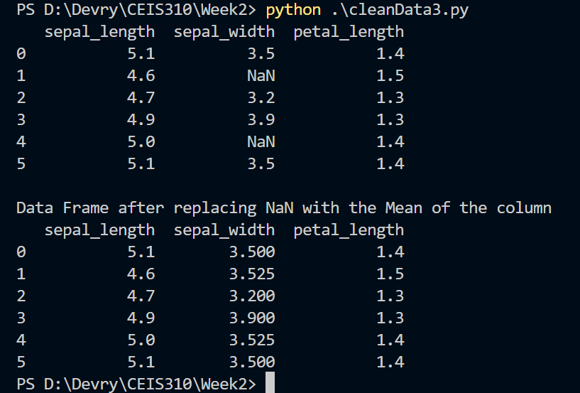
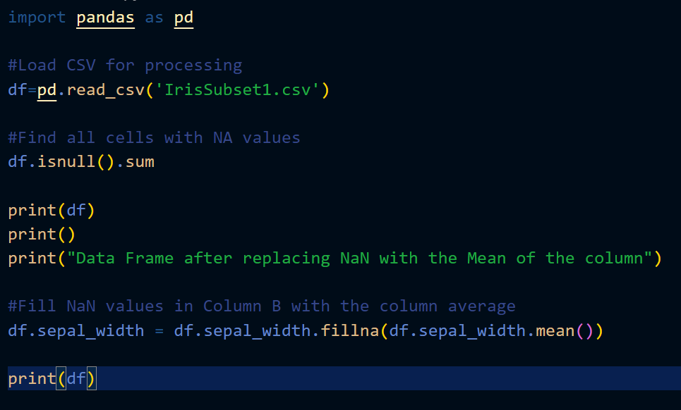
Screenshot of Activity A
Include a screenshot of your output and Python code For Activity A with your name and date in the comments.

Slide 4
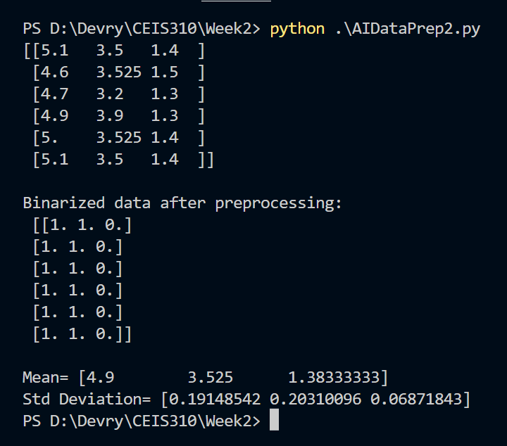
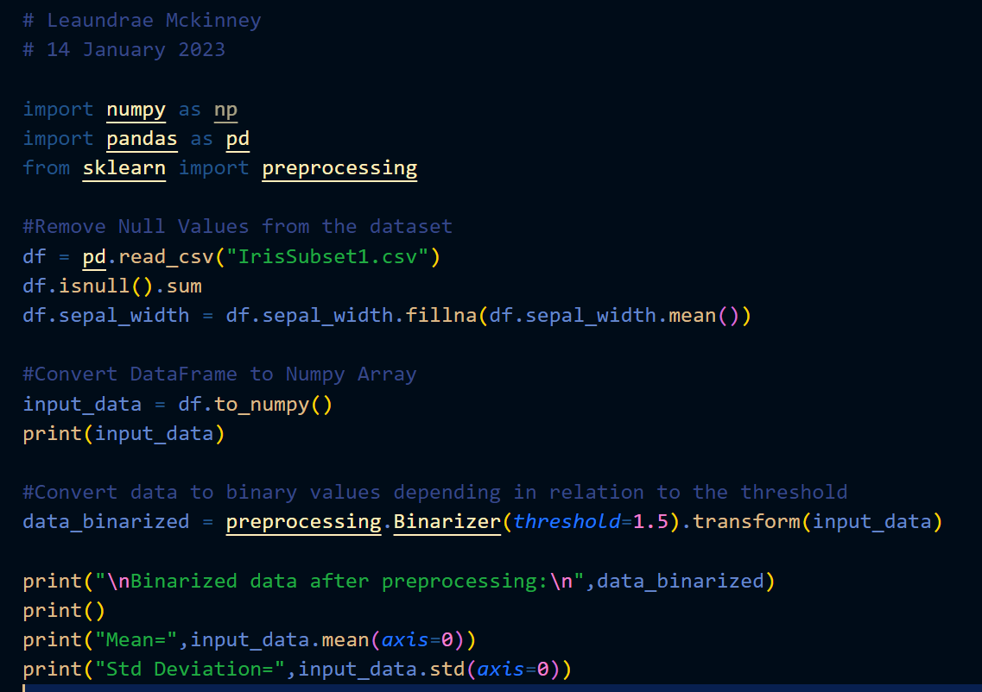
Screenshot of Activity B
Based on the sepal length and petal length we can reasonably predict the sepal width to be approximately 3.525.

